Slide 1
Lake Gaston
Water Safety Council (LKGWSC)
What Does LKGWSC Do For You?
Why Should You Become a Member?
March 30, 2022

Slide 2
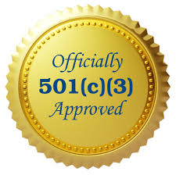
Who We Are
Organized February 22, 1989
Non-profit 501(c)(3) Organization
Serve Lake Gaston boaters in North Carolina and Virginia
Work with the U.S. Coast Guard Auxiliary
  Boater safety training conducted by U.S. Coast Guard Flotilla 93

Slide 3

Our Mission
Promote safety in all water-related programs and activities
Provide free recreational safety kits to the public
Distribute water safety information through media, road signage and waterside posters

Slide 4
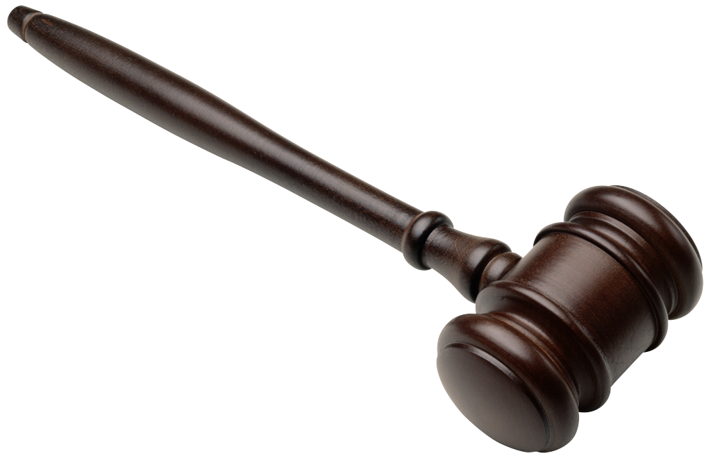
2022 Board of Directors
Officers
President: Wyatt Andrews
Vice President: John Dyckman
Secretary: Brian Goldsworthy
Treasurer: Debbie Andrews

Slide 5

2022 Board of Directors
Directors
Membership: Susie Deschenes
Life Jacket Loaner Program: Lin Harbold
Public Safety/Emergency Mgt: Lew Stringer, MD
Government Resources: Steve Harris
Ex-Officio: Will Miller (Dominion)

Slide 6
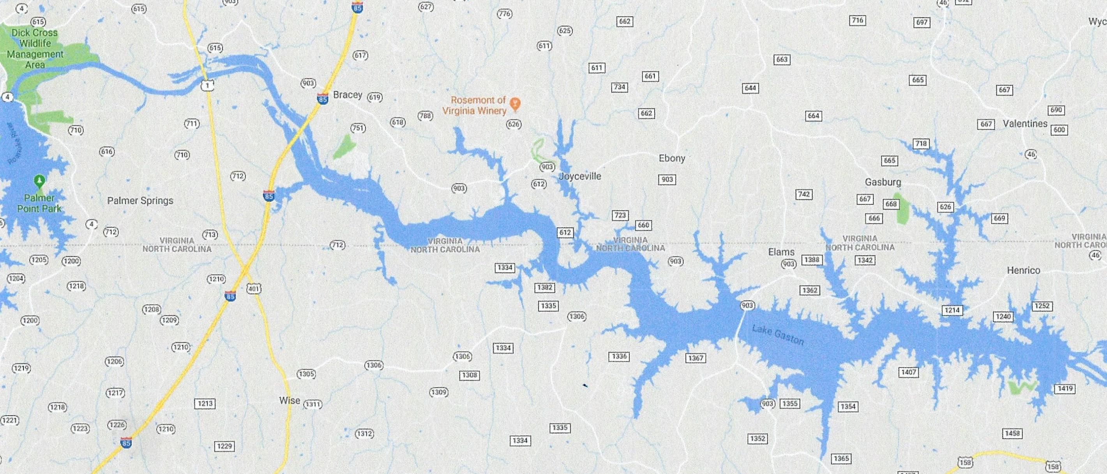
Lake Gaston
20,000 Acres
35 miles long
350 miles of shoreline
Maximum depth = 95 ft
Average depth = 40 ft
199 ft above sea level
4 generators @ 55 megawatts each

Slide 7
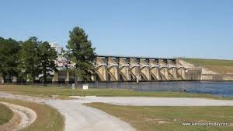
Lake Gaston Dam

Slide 8
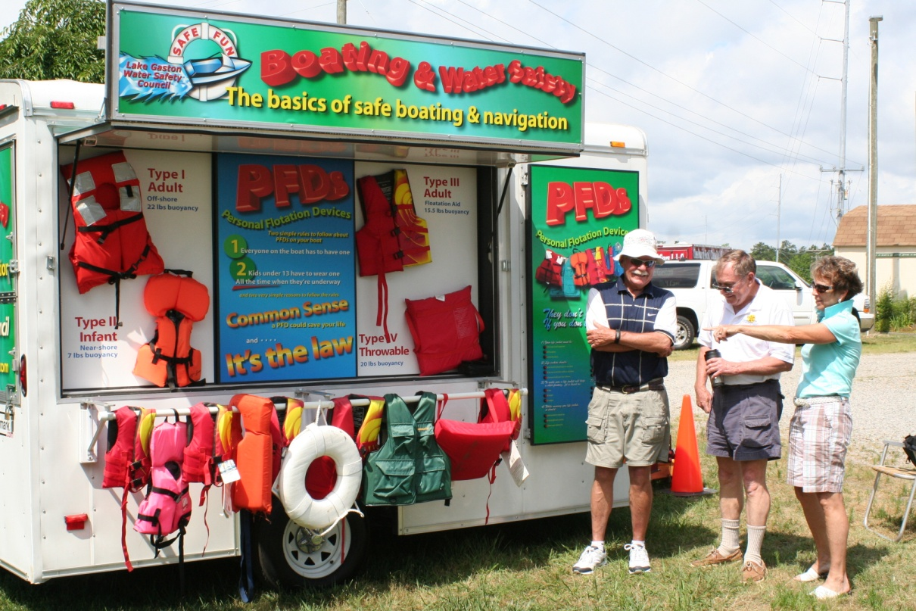
Our Successes
Water and boating safety training
Created Safety Trailer to promote water safety
  10-18 events annually
  600+ visitors

Slide 9

Our Successes
Promoted the formation of the U.S. Coast Guard Flotilla
VHF marine radios to local marinas
Life Jacket Loaner Program

Slide 10
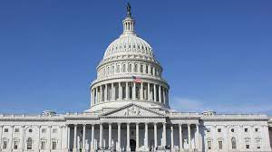
Our Successes
Key role in the NC Safe Boating Alliance in support of Safe Boating Legislation
  Member appointed to Joint House/Senate Study Team
  Mandatory boating safety training

Slide 11
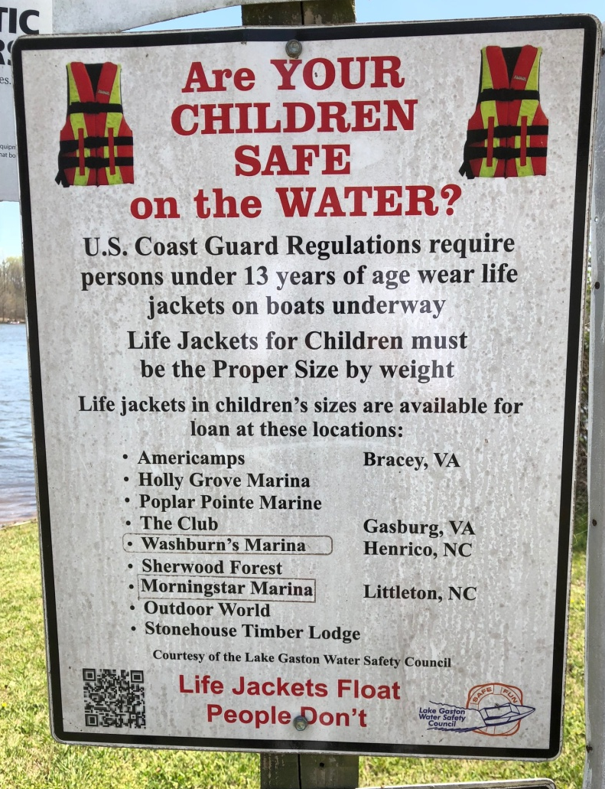
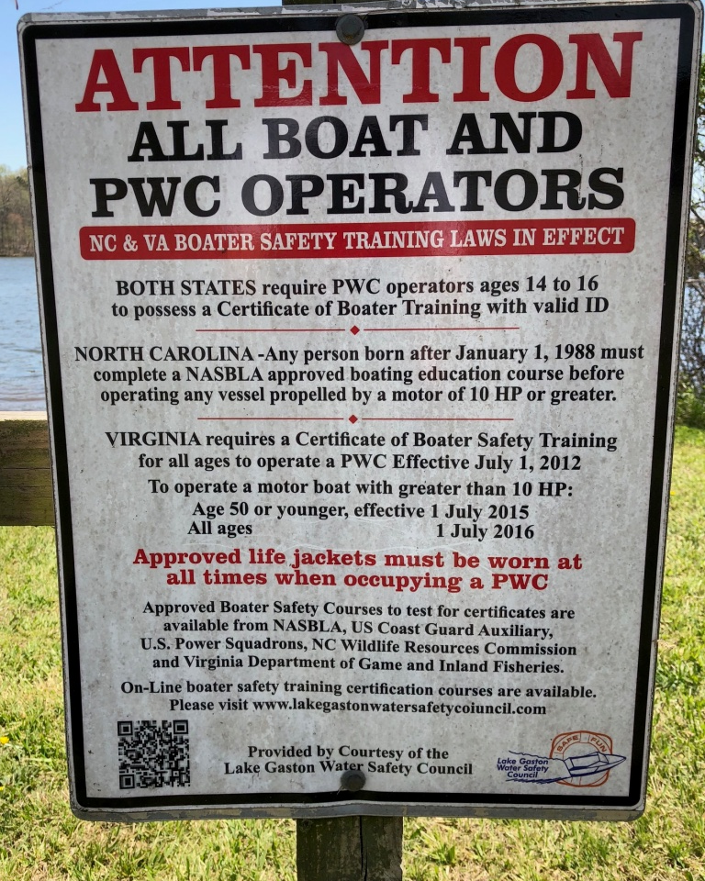
Our Successes
Boat launch signage

Slide 12
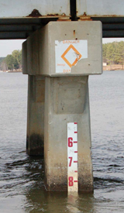
Our Successes
Increased lighting on bridges and causeways
Bridge clearance height markers

Slide 13

Partners
Dominion Energy
City of Virginia Beach
NC Wildlife Resources Commission (NCWRC)
VA Department of Wildlife Resources (VDWR)
Lake Gaston Association (LGA)
Water Sports Industry Association (WSIA)
U.S. Coast Guard Auxiliary, Flotilla 93
Lake Gaston Chamber of Commerce
Lake Gaston Striper Club

Slide 14
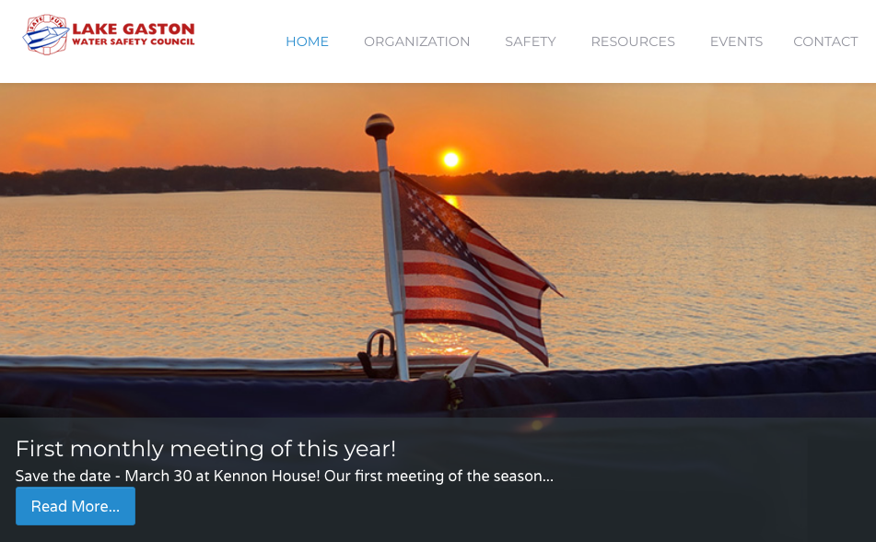
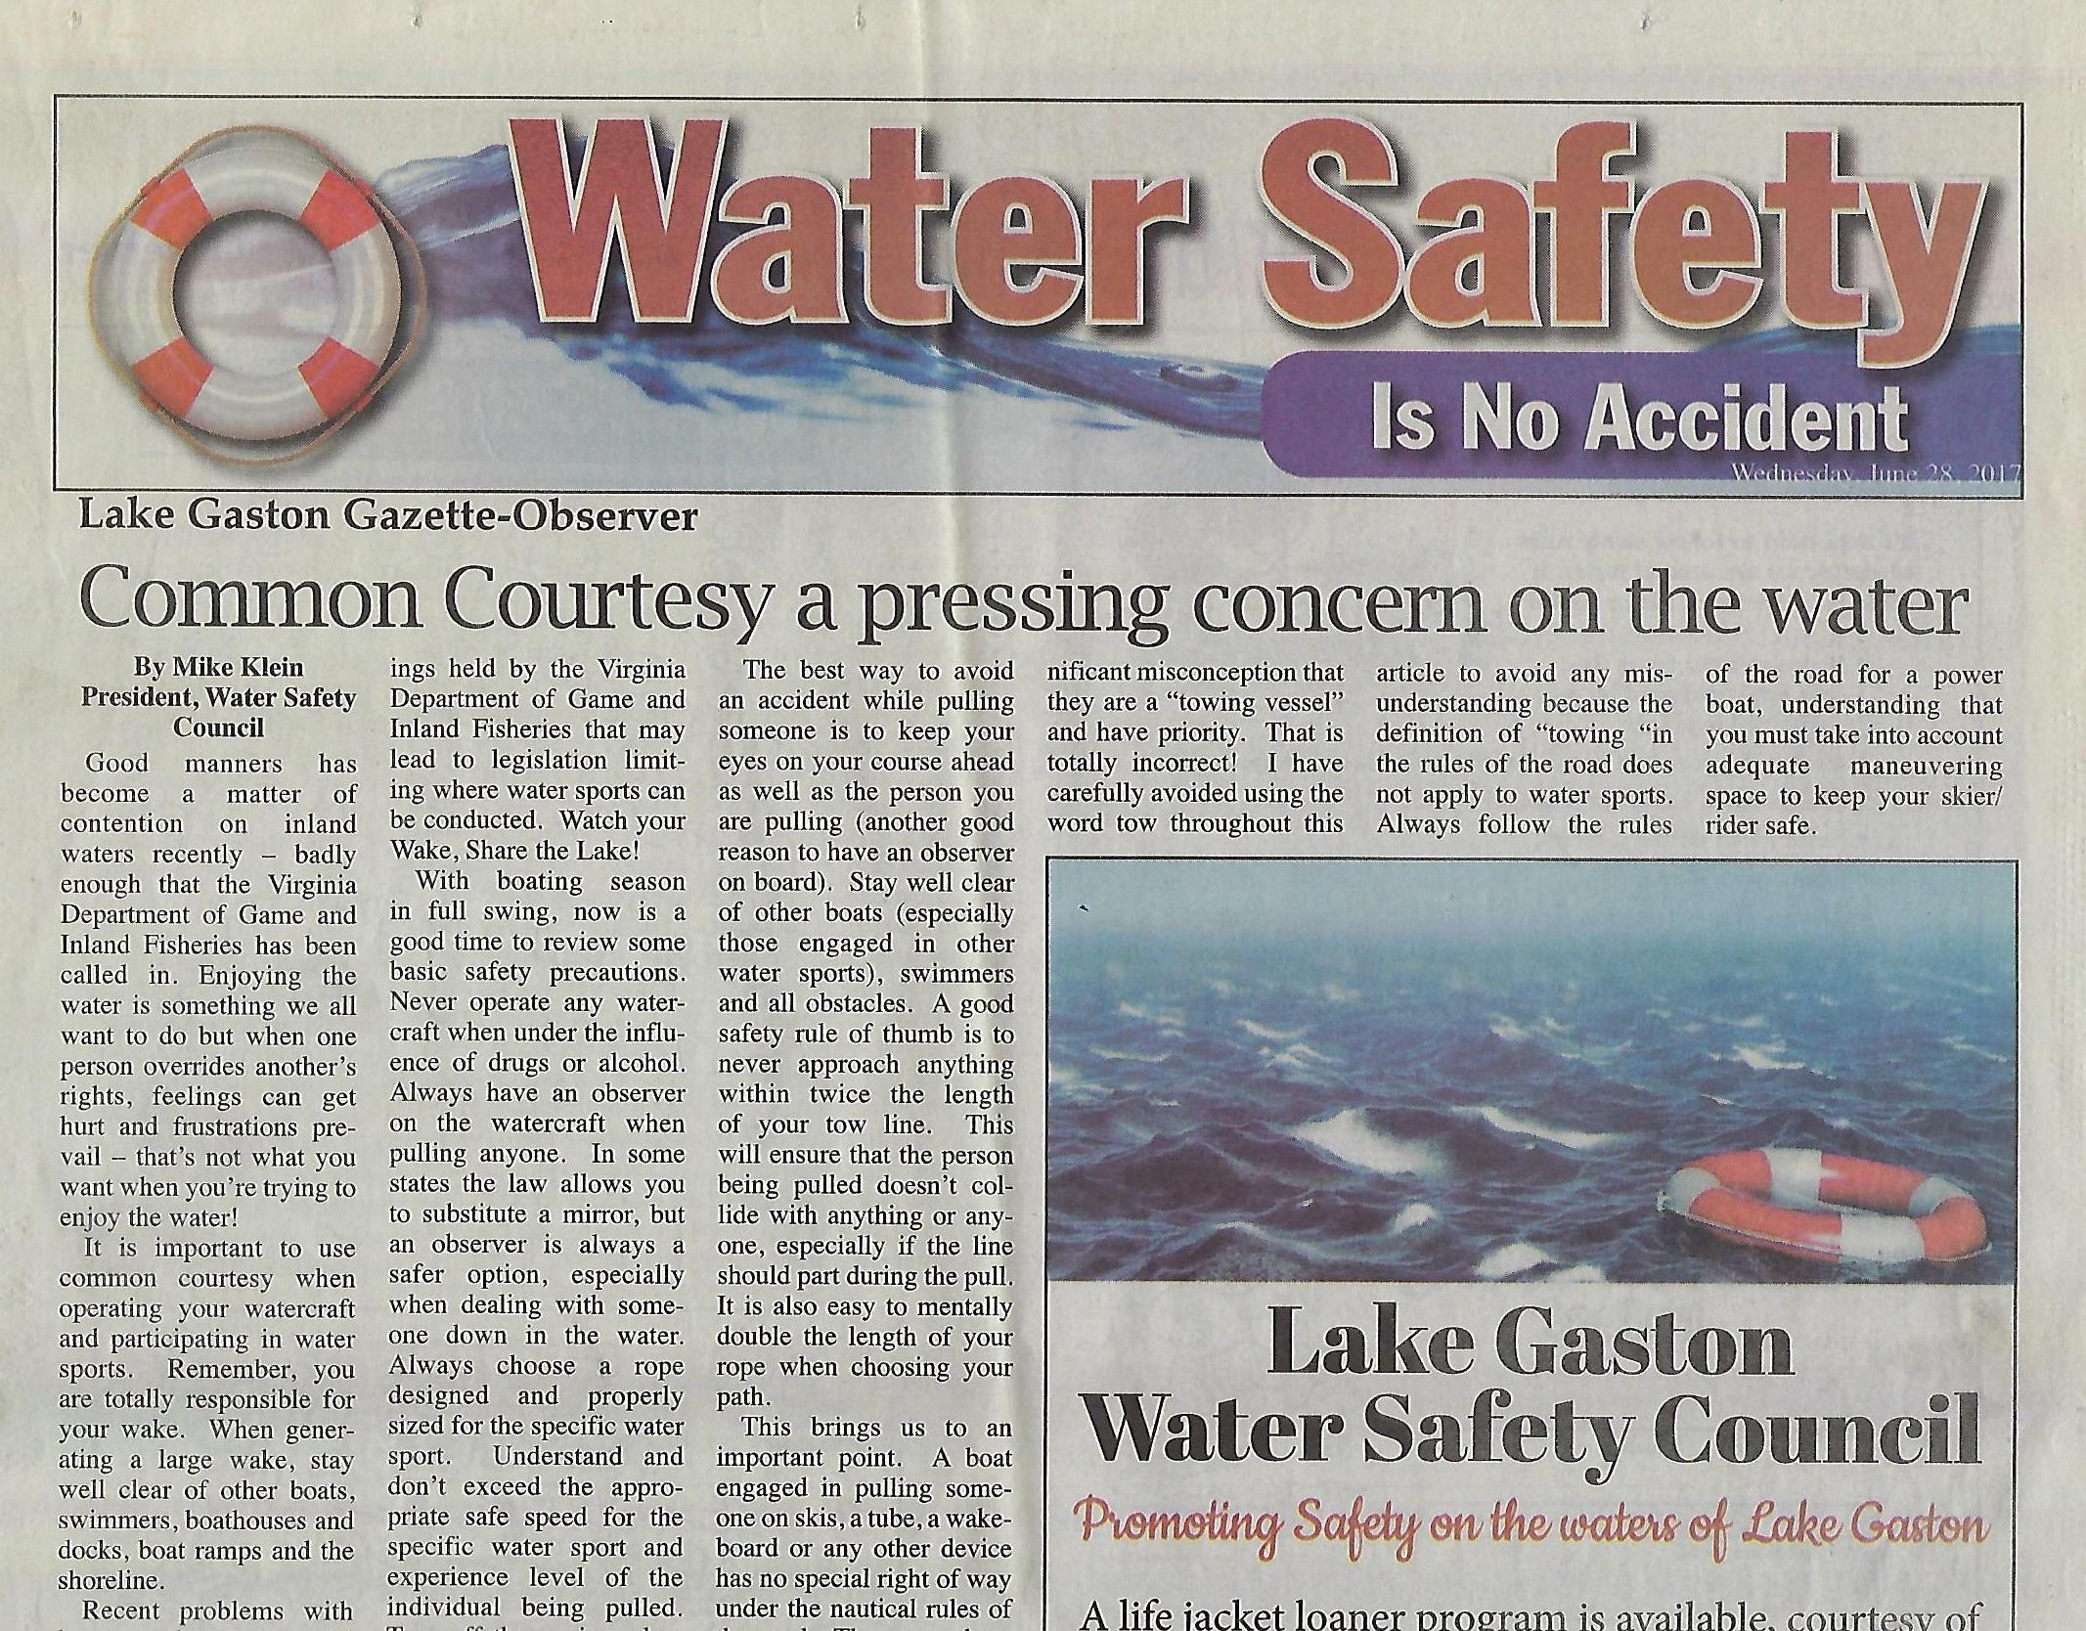
Publicity
John Dyckman
Media
Publications
Website: lkgwsc.org
Facebook
Get Home Safely Program
Safety Trailer

Slide 15
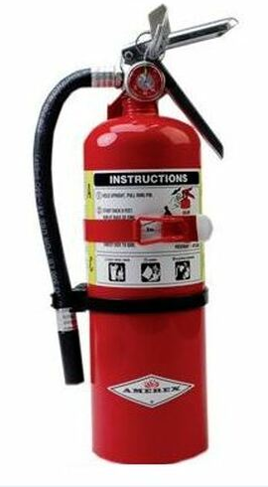
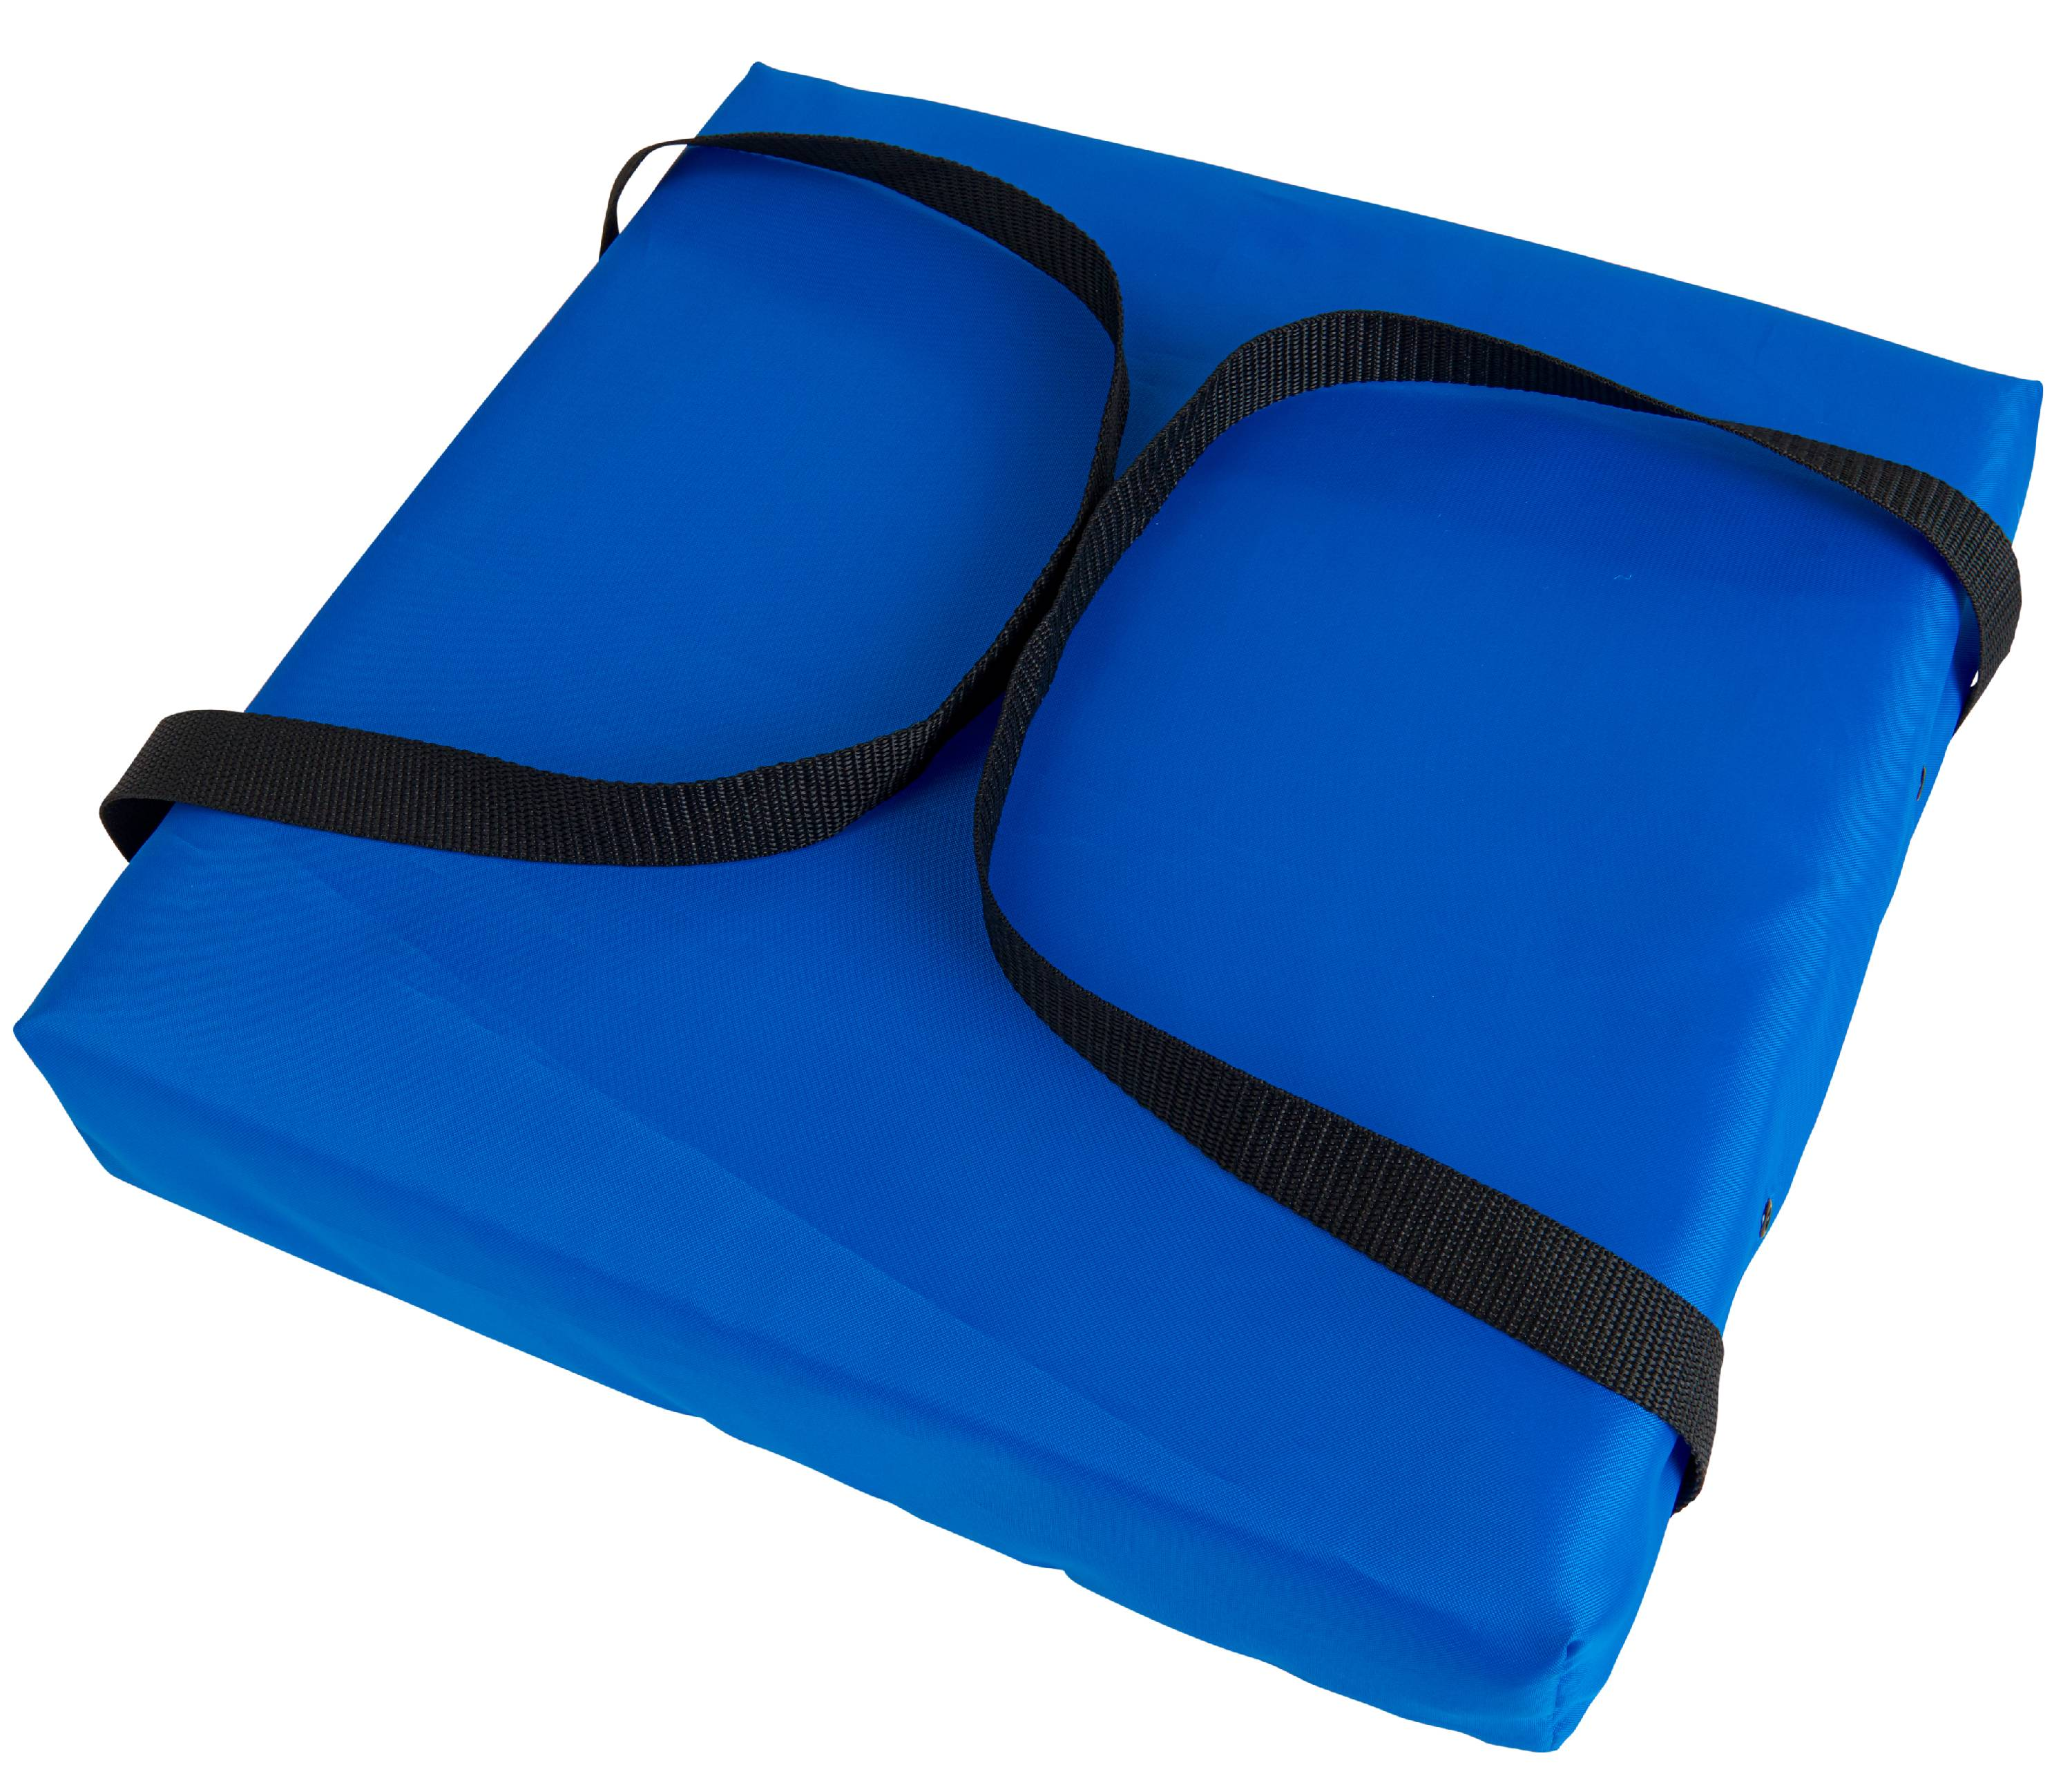
Get Home Safely Program
Provide U.S. Coast Guard officers with fire extinguishers and throw cushions for cited boaters

Slide 16
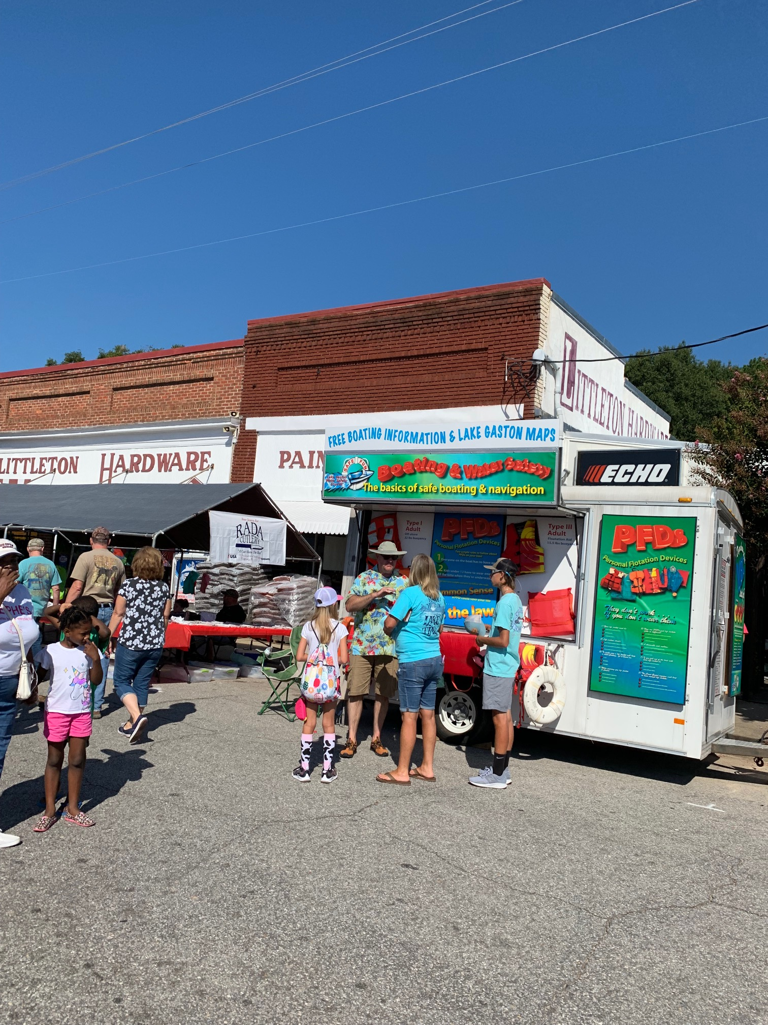
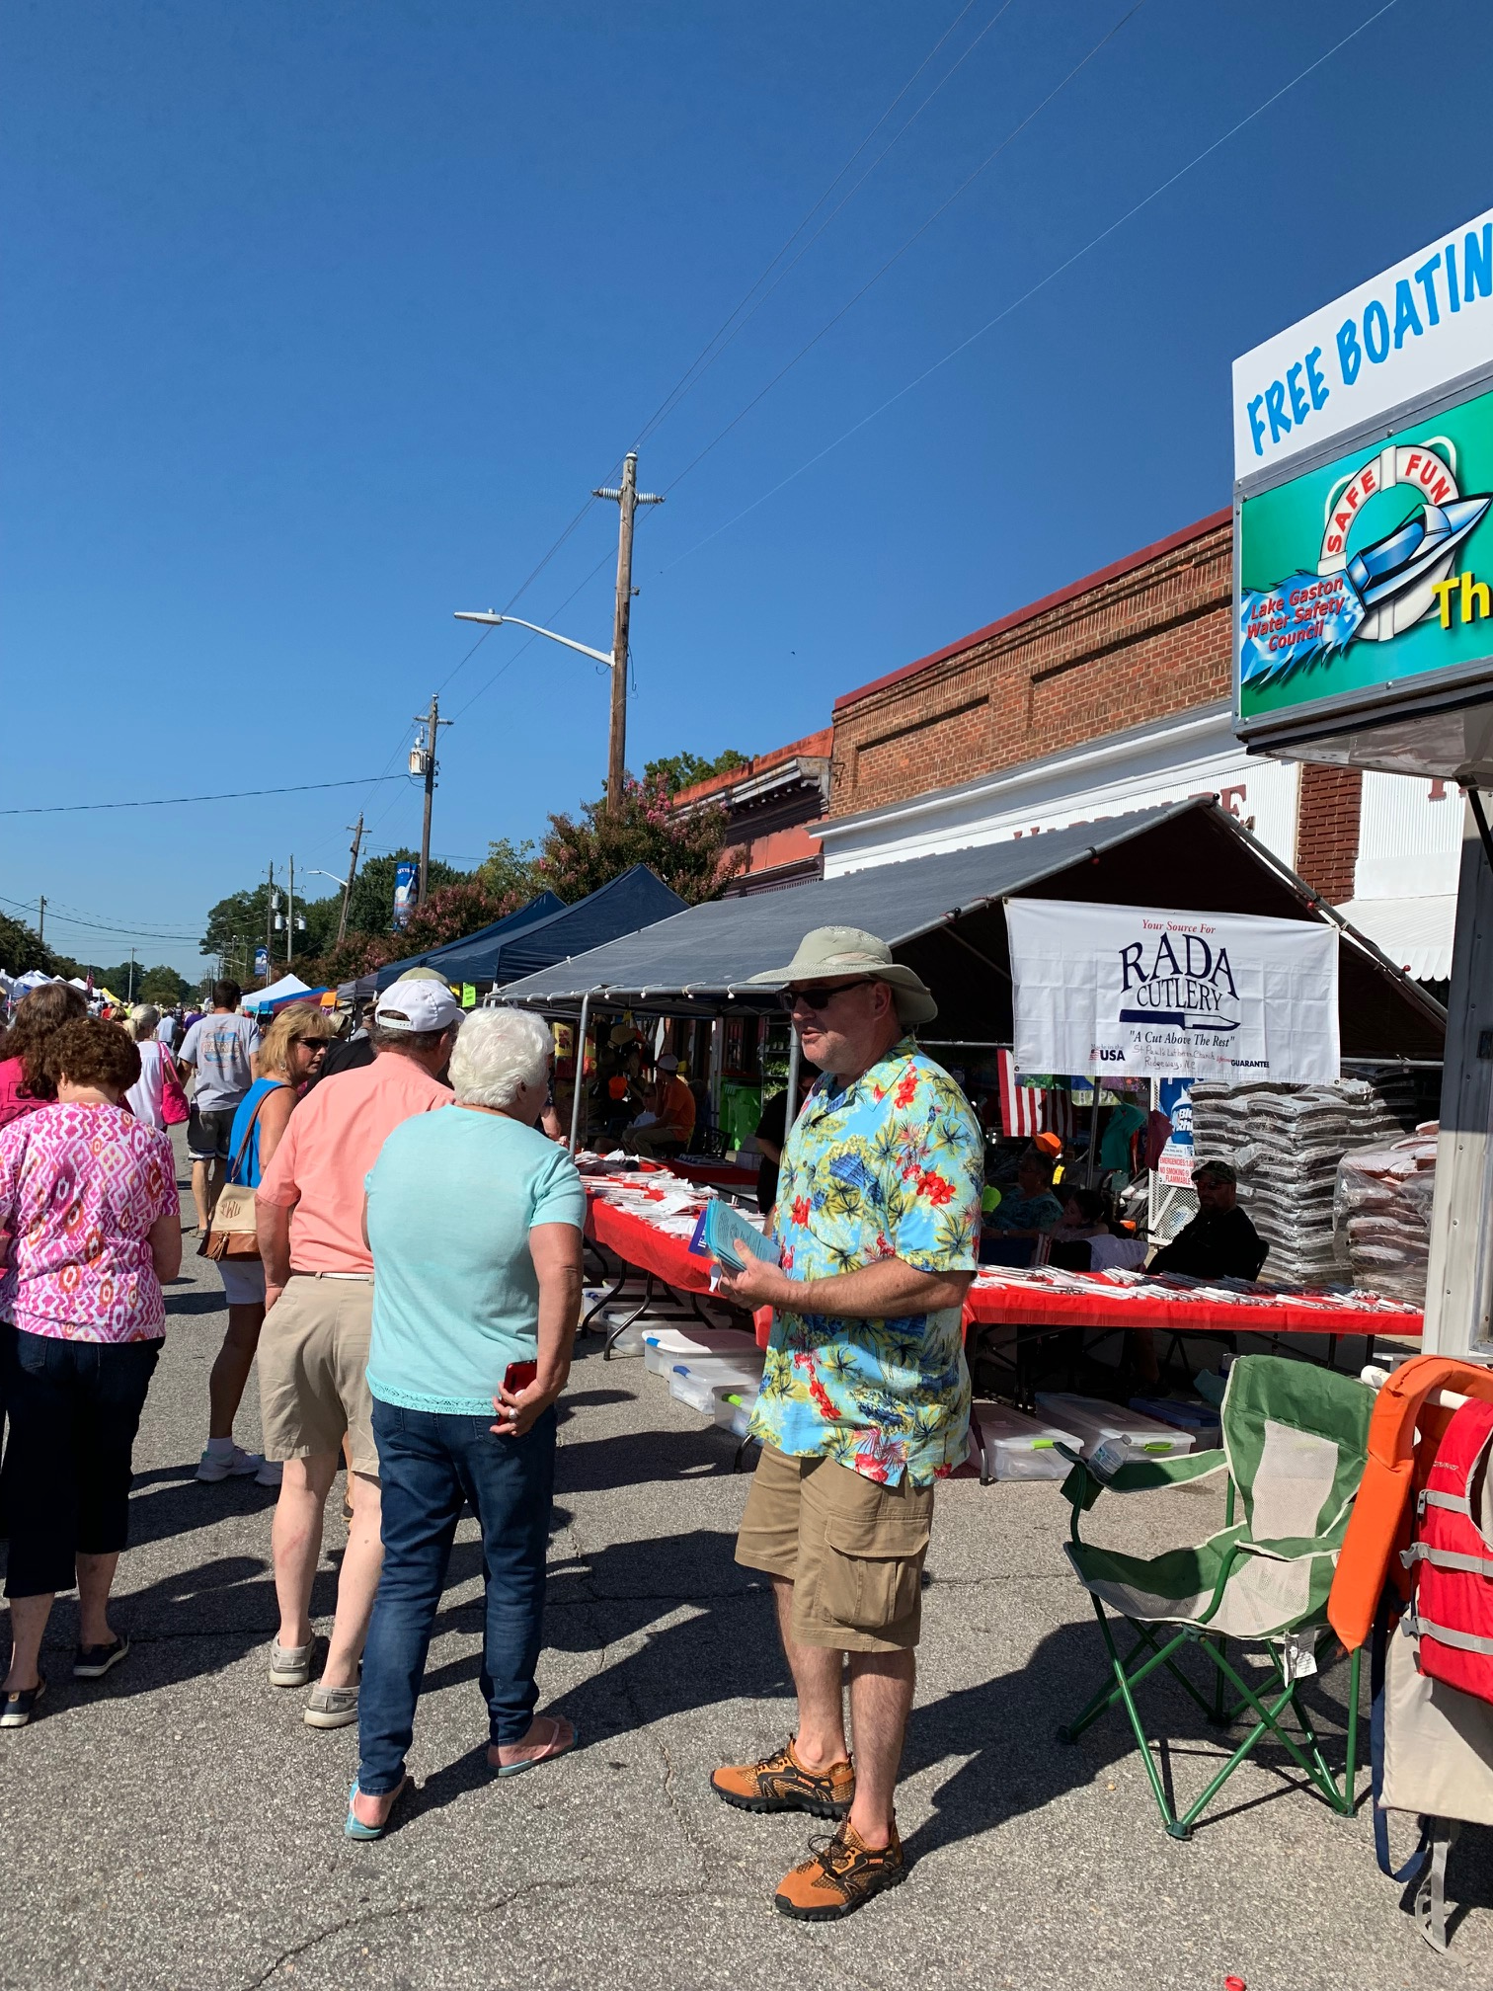
Safety Trailer
At Public Events

Slide 17
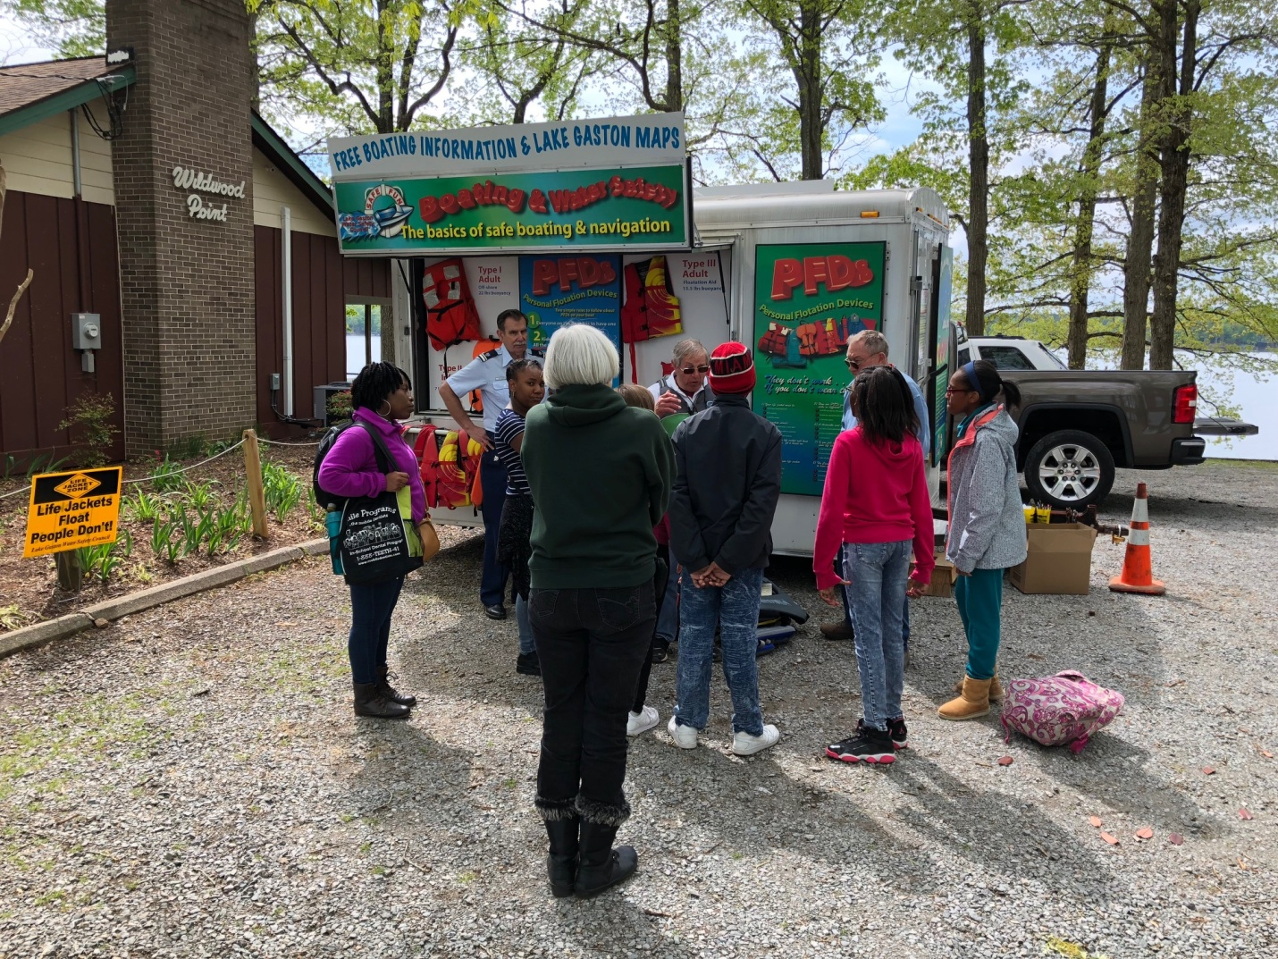
Safety Trailer
Lakeside with
Middle School Students

Slide 18
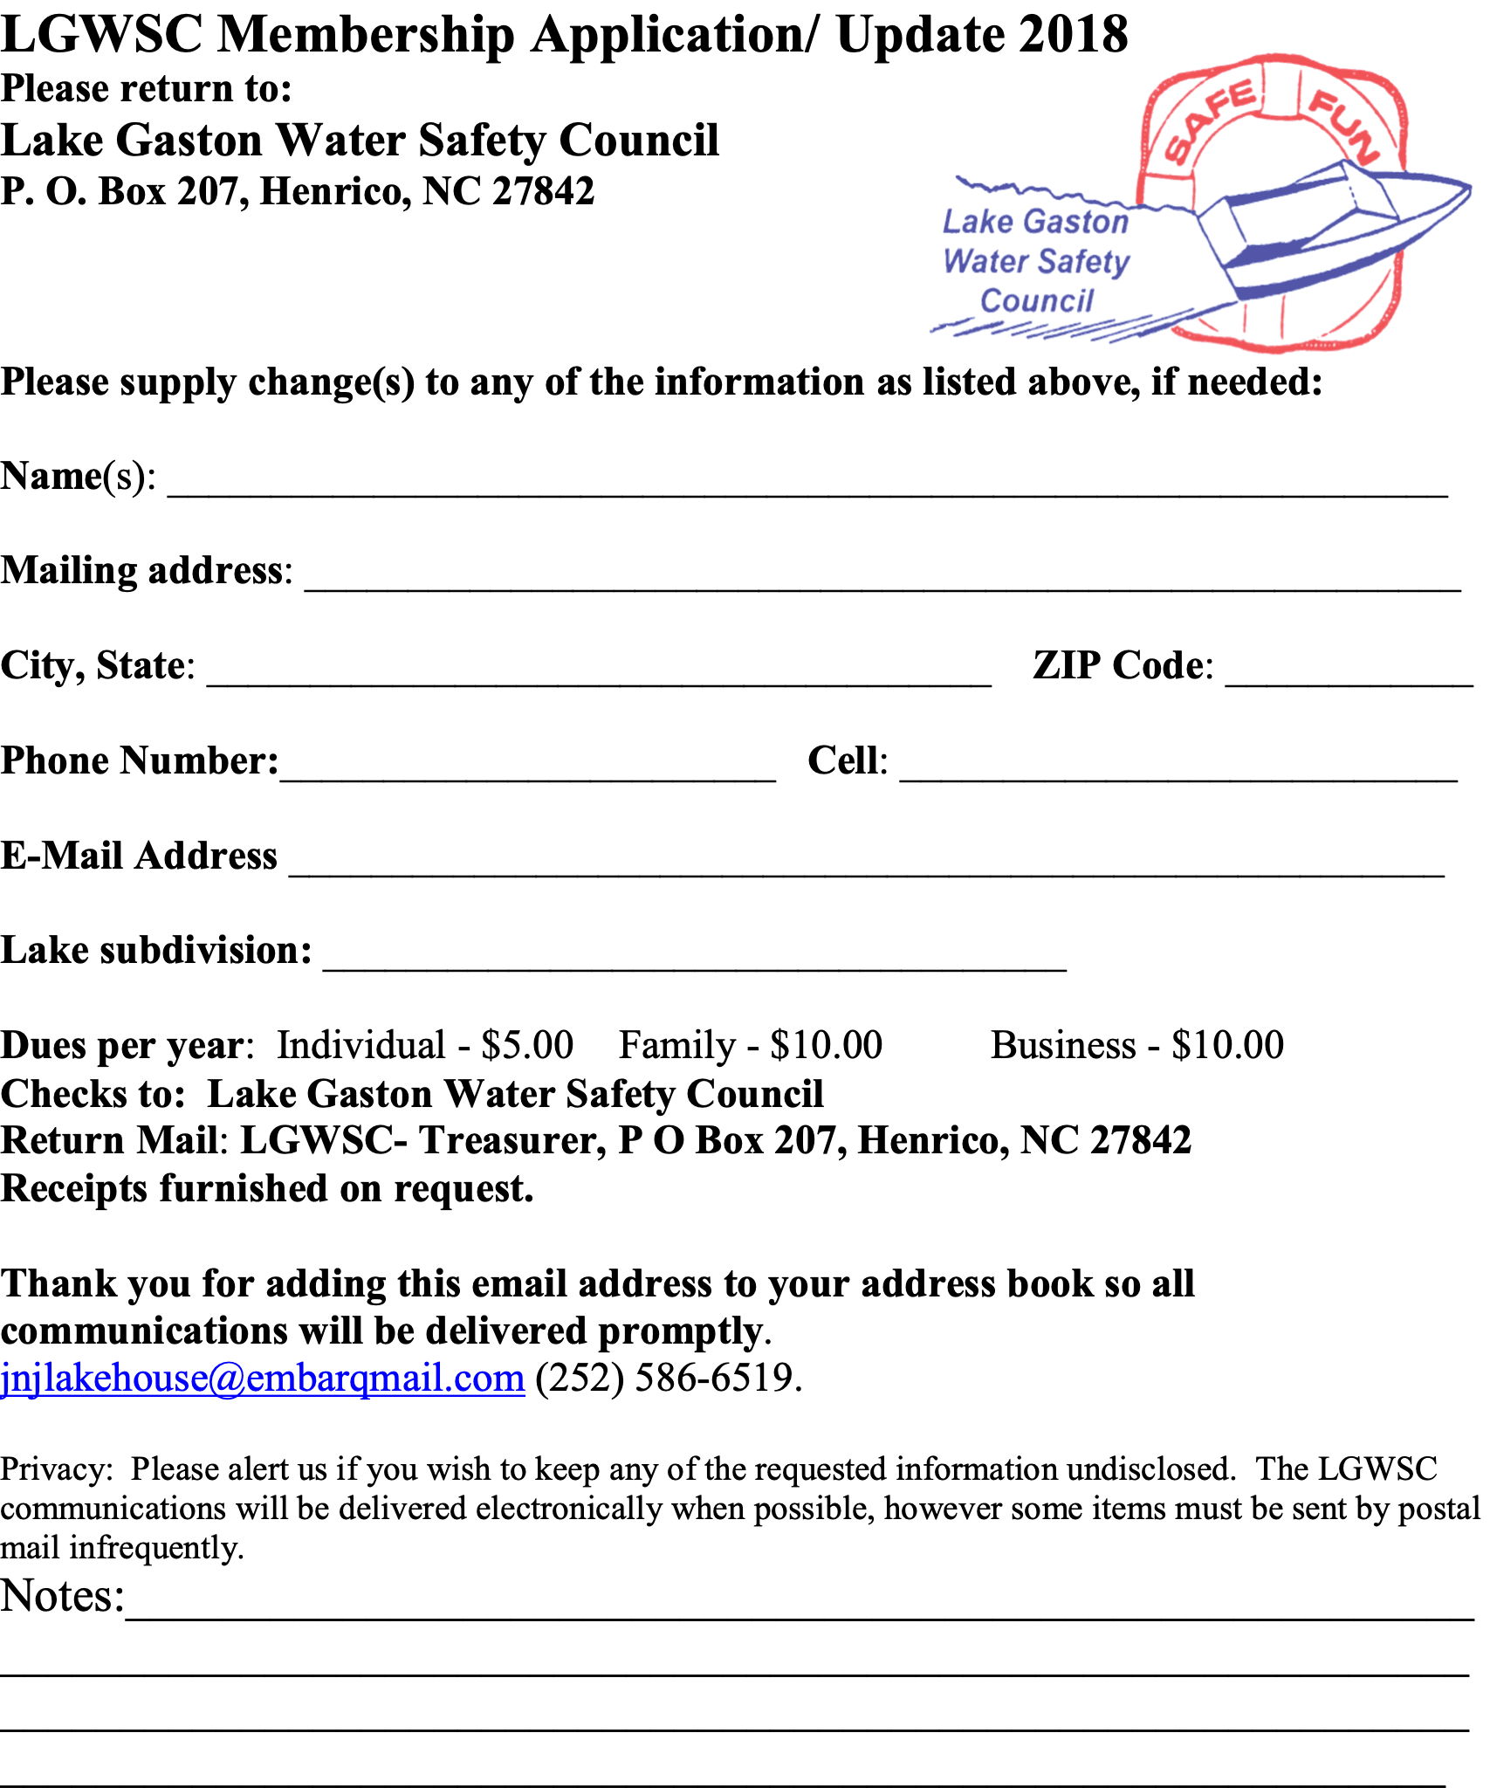
Membership
Susie Deschenes
Maintain Membership Roster
Solicit new members and process membership applications when received
Meet & Greet members and guests at all meetings
Coordinate WSC/Real Estate Partnership
2022

Slide 19
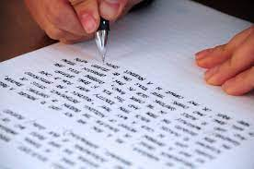

Secretary
Brian Goldsworthy
Keep detailed minutes of all Board and general meetings
Distribute minutes to members after approval
Acknowledge gifts and send thank-you cards
Manage and update website lkgwsc.org

Slide 20


Treasurer
Debbie Andrews
Prepare annual budget
  Membership dues
  Private Donations
  Dominion Energy
  Virginia Beach
Provide monthly report of income received and expenses paid
Submit all records to Auditing Committee at the end of the fiscal year

Slide 21
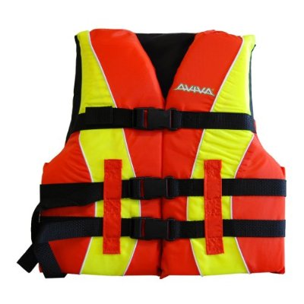
Life Jacket Loaner Program
Lin Harbold
Children under the age of 13 must wear U.S. Coast Guard approved life jacket at all times on moving vessels
Provided free-of-charge
9 partner locations around the lake (in NC and VA)

Slide 22
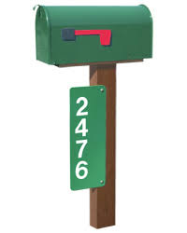
Public Safety/Emergency Mgt: Lew Stringer, MD
9-1-1
Emergency Address Sign
What to Say When
You Call 9-1-1

Slide 23
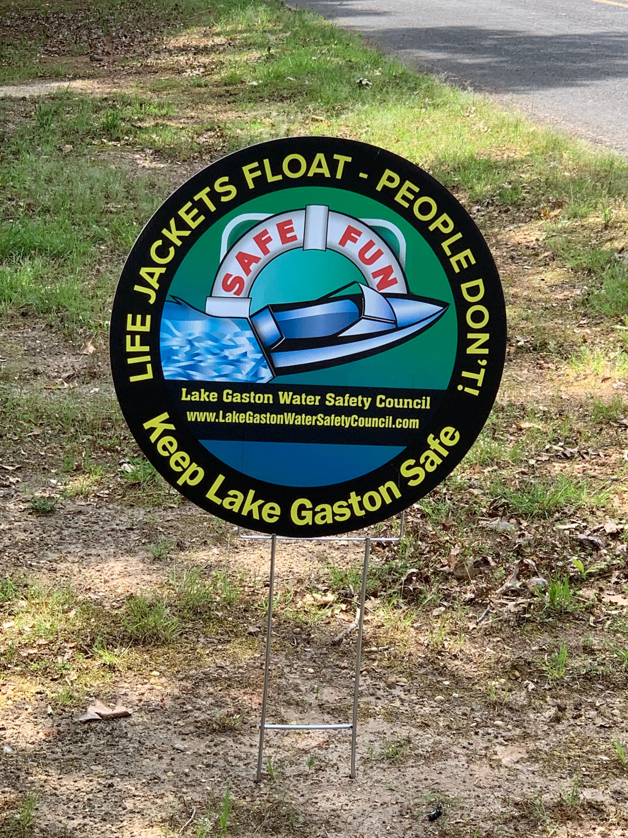
Public Safety/Emergency Mgt
THE LIFE YOU SAVE MAY BE YOUR OWN!

Slide 24
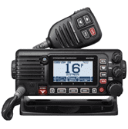


Government Resources
Steve Harris
Operation and maintenance of VHF Marine radios at marinas
Coordinate safety and wildlife resources with local Government agencies

Slide 25

Volunteers Needed
Please Join Us!
Board of Directors and General Membership participation is 100% volunteer
Annual Dues
$5 – Individual
$10 – Family
$10 – Business

Slide 26

Questions?
Thank you!

